Slide 1
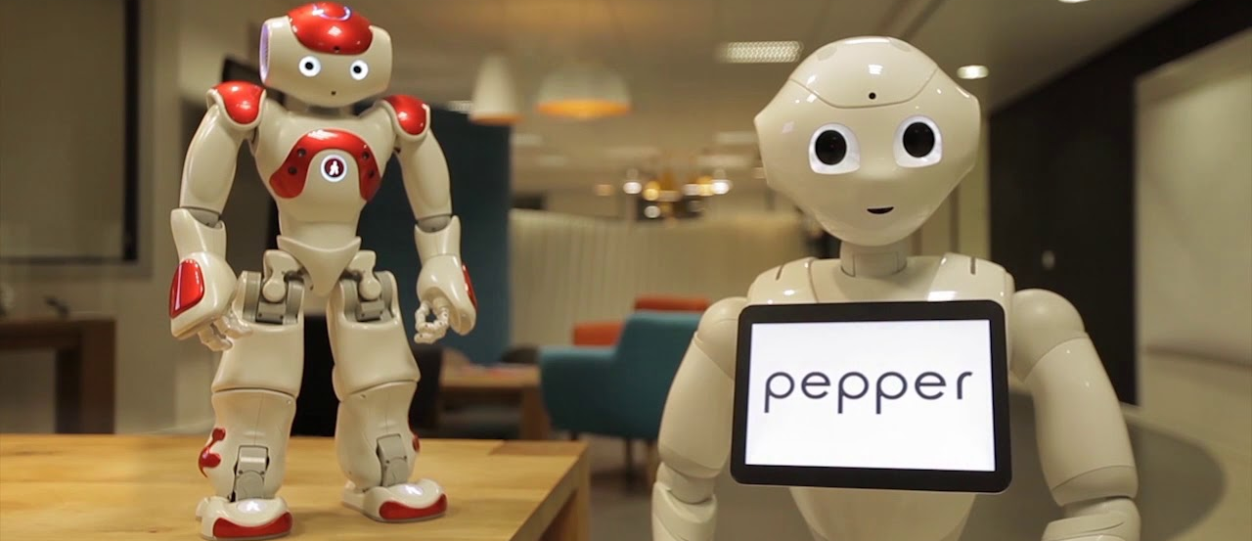
NAO and Pepper Tutorial
Margot Neggers Raymond Cuijpers m.m.e.neggers@tue.nl r.h.cuijpers@tue.nl
Technische Universiteit Eindhoven Human-Technology Interaction

Slide 2
Topics
The NAO Robot
The Pepper Robot
Reserving the robots
Using Choregraphe
Using Python
Using NAO lib

Slide 3
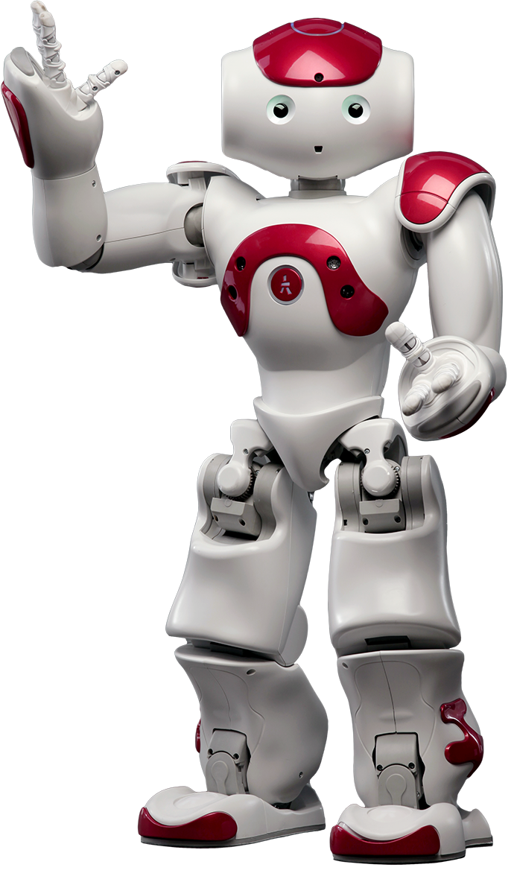
The NAO Robot
60-cm tall humanoid robot
Bender Robby
(which movies/cartoons are the names from?)

Slide 4
Working with NAO
Unbox NAO
Carry NAO at the waist
Before switching the robot on: plug in the router
Chest button
On (1 press) “OGNAK GNOUK”
Off (4 seconds) “GNOUK GNOUK”
When on (1 press) “Hello, I am Marvin. My Internet address is … + Status notifications”
When on (2 press) Switch on/off autonomous life

Slide 5
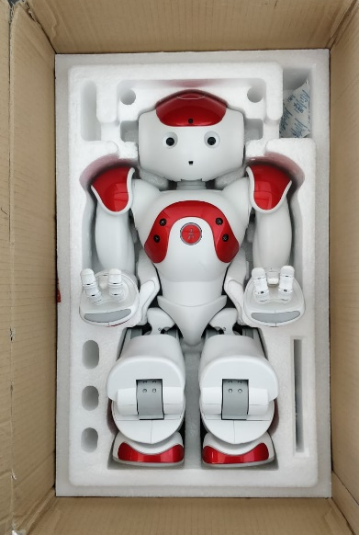
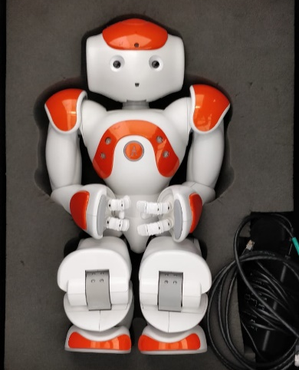
Working with NAO
While testing
First test on simulated robot if possible
Always place the robot on the floor
Always use soft foam behind the robot
Charger goes in the back
Putting the robot back in the box
It only fits in one way
If you cannot close the suitcase/lid: move the robot until the lid closes
Do not push the lid

Slide 6
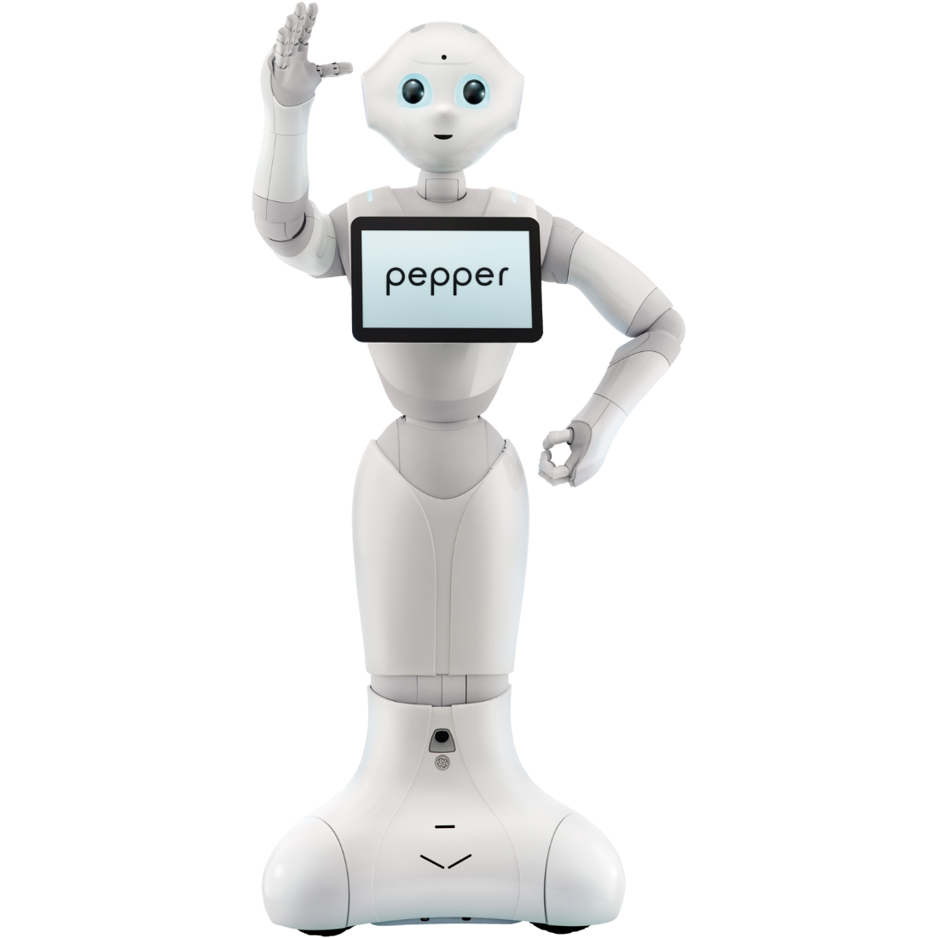
The Pepper Robot
120-cm tall humanoid robot
Eve

Slide 7
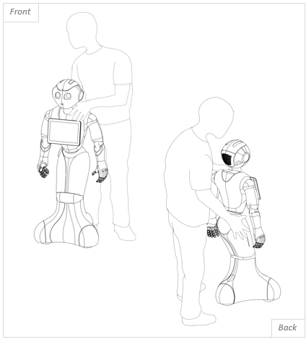
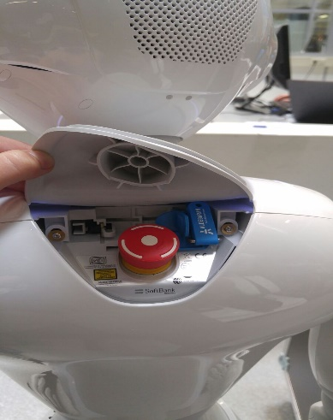
Working with Pepper
Preferably only move Pepper when it is turned off
One hand on the hip and one on the shoulder
If it is turned on, only move in crouch mode and with power hatch open!
Chest button
On (1 press) “OGNAK GNOUK”
Off (4 seconds) “GNOUK GNOUK”
When on (1 press) “Hello, I am Eve. My Internet address is … + Status notifications”
When on (2 press) Switch on/off autonomous life
Emergency turn off: Red button in neck
You DO NOT need to OPEN FLAP

Slide 8
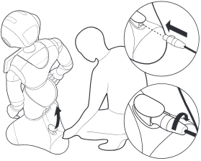
Working with Pepper
While testing:
Make sure Pepper has enough space to move around
Charger goes in the foot, turn the charger right until it clicks
After turning the robot off, leave it in the lab. It does not have to be put in its box

Slide 9
NAO Robot and Pepper robot
Questions/or more details needed?
http://doc.aldebaran.com/2-4/index.html
(or check out the help function of choregraphe)

Slide 10
Reserving the robots
NOT necessary for course 0HVR00 and 0HM280!
Complete the Robot Tutorial Workshop and we will register your name
Go to cluster market, login with your student account at https://clustermarket.com
Choose H&T Labs Reservation System and select the robot from Equipment
Schedule a time slot
Reserve a lab/room (Atlas building only) for using the robot using cluster market
Works the same as equipment
Notify the appropriate HTI staff member/Lab support
Only when it is accepted you an receive the robot(s)

Slide 11
Reserving the robots
NOT necessary for course 0HVR00 and 0HM280!
Include in your cluster market time slot:
Names of people who will work with the robot
Location in Atlas
preferably the social robotics lab (also needs to be reserved)
Preferably on the 8th or 9th floor
Reason of reservation (experiment or testing code or education for <course name>)
Phone number of one of the students who are using it.

Slide 12
Using Choregraphe

Slide 13
Installation
Install Choregraphe 2.1.4 for NAO v4 and v5
Go to canvas and download
Choregraphe 2.5.10 for Pepper
Works also with Nao v4 v5
https://aldebaran.com/support/kb/softwares/pepper-2-5-downloads/
License is on the same site
Choregraphe 2.8.8 for Nao v6 (Robby)
https://aldebaran.com/support/kb/nao6/downloads/nao6-software-downloads/
License is on the same site

Slide 14
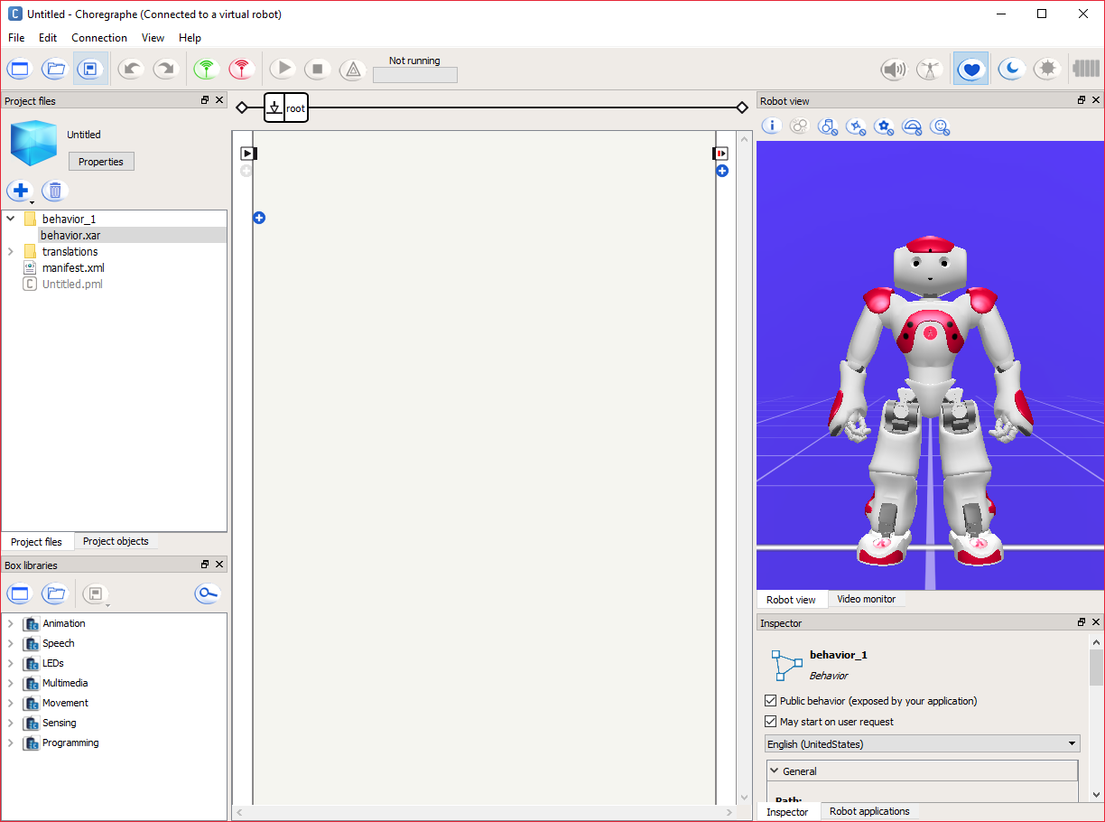
Using Choregraphe
Connect
Autonomous life
Robot view
Drag behaviors
here
Behaviors

Slide 15
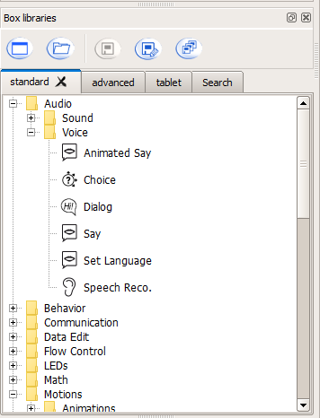
Behaviours

Slide 16
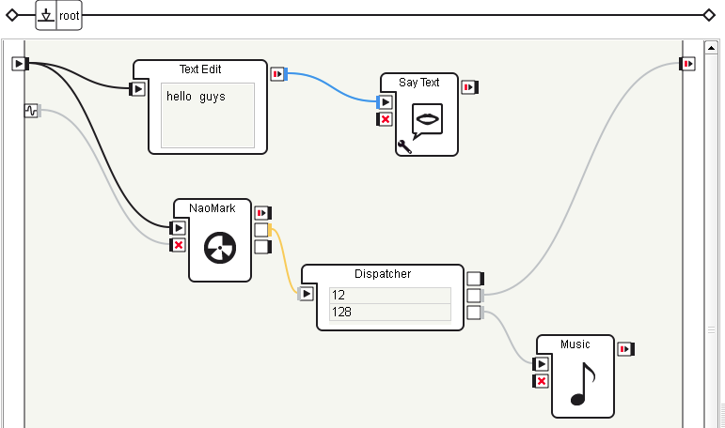
Example

Slide 17
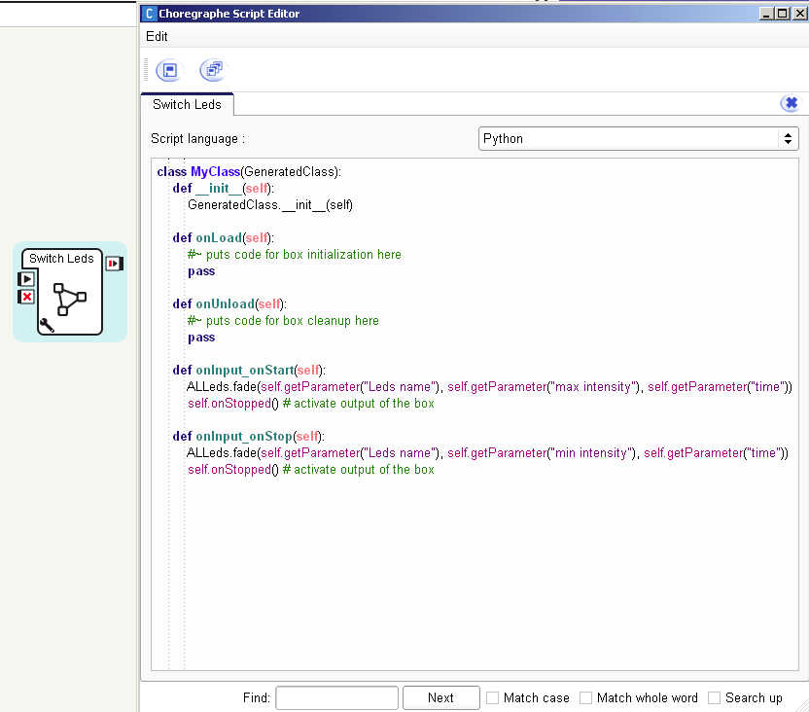
Adjust code

Slide 18
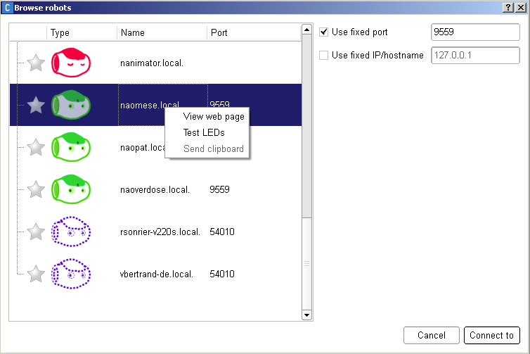
Connecting with the real robot
Only one Choregraphe at the same time

Slide 19
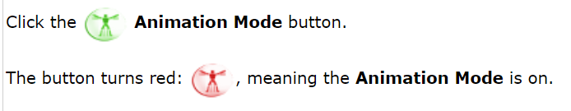
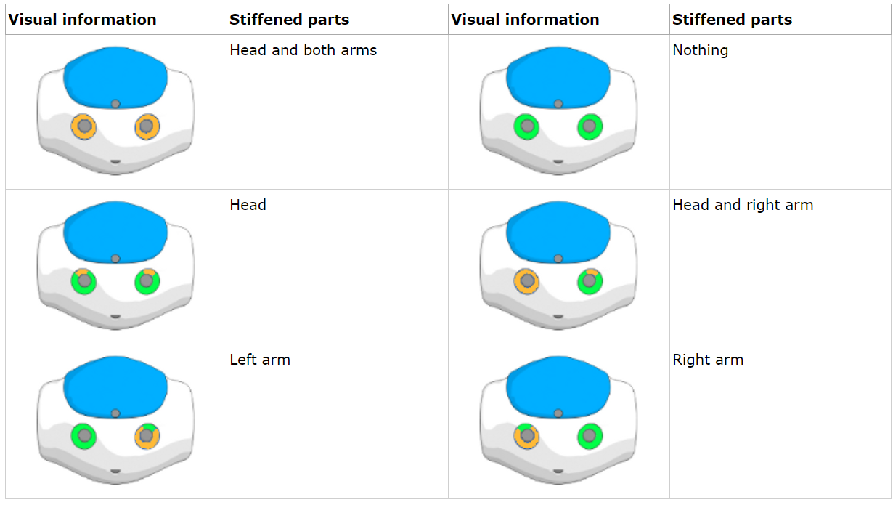
Creating animations
Using animation mode
Watch the color of the eyes
Adjusting the joints of the virtual robot

Slide 20
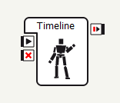
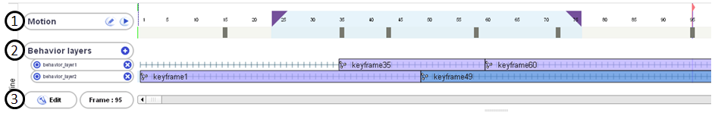
Timeline
(1) Upper part timeline with numbered frames. Lower part contains the keyframes
(2) list of parallel behaviors
(3) timeline edit button, the current frame indicator, and the general timeline scrollbar.

Slide 21
Animating the robot
The timeline box is extremely handy to program gestures and movements.
It contains a nice graphical interface for stop-motion animation of the robot
Best of all, the gesture/motion can be exported to python and “run” using the nao.RunMovement() command
Use Edit button for advanced features
Right click here for direct animation

Slide 22
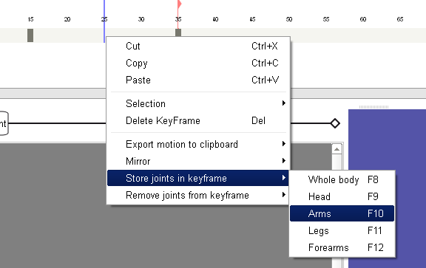
Right click on the timeline gives acces to store joints and to export it to python/c++

Slide 23
Directly storing keyframes
Move the robot into the desired posture manually
Turn arm/leg/head/body motors off and move limb into position
Select a frame position on the timeline
Press (or use context menu of timeline, see below)
F8 Store Whole body, F9 Store Head
F10 Store Arms, F11 Store Legs
Repeat until entire movement is programmed
Right click on timeline to activate the context menu
Choose Export Motion to Clipboard/Python/Bezier
Note: the framerate is normally 25 frames/second, so DO NOT put keyframes to close to each other or you will get very fast movements
Always test with virtual robot first

Slide 24
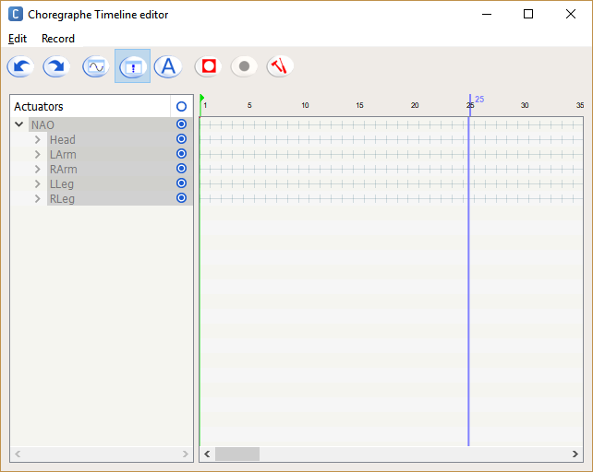
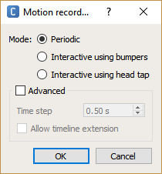
Advanced stop-motion recording
Make sure to enable recording buttons
Choose settings for selecting an advanced recording mode
You can select here which joints or joint groups to record
Check manual for details!

Slide 25
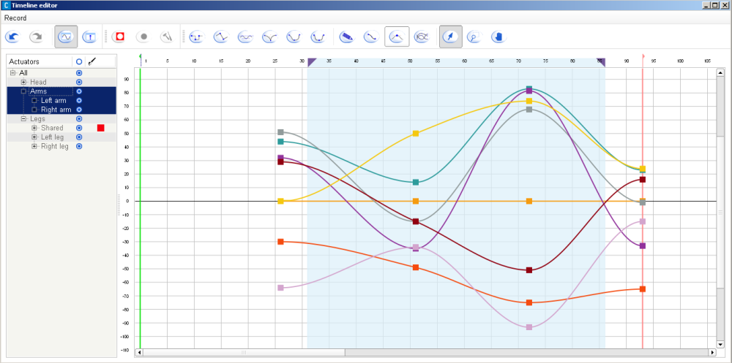
Editing recorded motions

Slide 26
Using Python and Naoqi

Slide 27
Manual Python Installation
Install the 32-bit version of Python 2.7
Install the Naoqi SDK for Python (2.1.4 for NAO and 2.5.5 for Pepper)
Open the Python editor “Idle” and open a Python shell
Type
import naoqi
If you get no error messages Python and Naoqi are installed correctly
You can use pip (Python Package Installer) to install packages
In Windows: run cmd
Type python –m pip install

Slide 28
WinPython Installation (Easier!)
Install WinPython (see handouts)
Includes most important extensions/libraries
Register WinPython using the WinPython Control panel
Install the Naoqi SDK for Python
Open the Python editor “Idle”
open a Python shell and type import naoqi
If you get no error messages Python is installed correctly

Slide 29
Troubleshooting
Make sure Python and Naoqi are installed in the right location
Check the Python Path, add the location of Python and Naoqi to the python path
Is Python 2.7 the only installation of Python?

Slide 30
Installation
Install numpy
Install scipy
OpenCV (if you need computer vision)
Other useful libraries
Tk (Universal window manager)
PIL (Python Image Library)
Matplotlib

Slide 31
OpenCV
OpenCV is a huge library
You can try to find an installer for windows (previous slides)
Or, you download it form opencv.org
Download and extract the files
Copy the cv2.pyd file to your Python distribution
I am using a 32bit machine with python 2.7
Look for the file <path_to_opencv>\build\Python\x86\cv2.pyd
Copy it to <path_to_python>\Lib\site-packages\cv2.pyd

Slide 32
OpenCV
Test your installation using
import cv2
We often use cv rather than cv2:
import cv2.cv as cv
To automatically do this, create a file cv.py in to <path_to_python>\Lib\site-packages\ with the following content:
from cv2.cv import *
This will enable the old “import cv” command

Slide 33
NAO-lib
A custom-built library simplifies many functions of Naoqi
Meant for NAO, and the naoqi-version of NAO
Latest version will be shared with you
nao.py includes cv
nao_nocv.py does not
Installing nao-lib
Create a directory with a python file with one line of code
import nao_nocv as nao
Copy nao.py or nao_nocv.py in the same directory
Press F5 to run and test the program

Slide 34
Simulated robot
Installing the simulated robot
Run the program naoqi-bin.exe that is installed along with Choregraphe
Note your local IP address or use “127.0.0.1”
Add the line
Nao.InitProxy(“127.0.0.1”, [0])
If all goes well you are connected to the simulated robot
You can use Python to move the virtual robot in Choregraphe

Slide 35
Simulated robot
Choregraphe
Run the program naoqi-bin.exe that is resides in the “bin” subdirectory of your choregraphe installation
Note your local IP address or use “127.0.0.1”
in your program add the line:
nao.InitProxy(“127.0.0.1”, [0])
If all goes well you are connected to the simulated robot

Slide 36
Simulated robot
Webots
Run the webots program
Download the naoqisim project from canvas/…
Accept acces to private and domain networks
Open sample world “nao_indoors.wbt” from downloaded project location
Note your local IP address or use “127.0.0.1”
in your program add the line:
nao.InitProxy(“127.0.0.1”, [0])
If all goes well you are connected to the simulated robot

Slide 37
Real robot
Connect the router
Start the robot by pressing the chest button
Press once on the chest button to hear Nao say its own ip address. If it cannot connect make sure the wireless configuration is ok (ask help)
Note the robot’s IP address e.g. “192.168.0.115”
in your program add the line
nao.InitProxy(“192.168.0.115”, [0])
If all goes well you are connected to the real robot

Slide 38
Real robot
General tips
To shut down the robot, press the chest button for 5 seconds
Testing
Test using the simulator! Just change the IP
If something goes wrong, press the chest button twice to release the joint stiffness (do this quickly like a double click)
Always pick it up by the waist
Always place the robot on the floor during testing
Put soft foam behind the robot

Slide 39
Simple commands
nao.Say(“Hello”)
nao.InitPose() #the robot stands up and its joints stiffen
nao.Crouch() #the robot sits down and releases its joint stiffness
Always start with InitPose and end with Crouch
It will stiffen and release the joints
It provides a standard posture
It prevents “overheating” if the crouches when doing nothing

